Slide 1
Pre Survey Information
0300AU0000

Slide 2
What is Tell Them From Me?
Tell Them From Me is an online student survey.
It is a series of questions that will help your teachers learn more about students at your school.
It is not a test.
No-one at your school will know that your answers came from you.
0300AU0000

Slide 3
Why are we doing it?
This is a chance for you to give your opinion on things that matter to you at school.
It will help your teachers and principal identify changes that can improve your school.
0300AU0000

Slide 4
How is it done?
Your teachers will decide on the best time and place for you to complete the survey (during school time).
Your teacher will give you a username and password… (don’t lose it, and keep it secret!)
You then go online (www.tellthemfromme.com) and enter the username and password given to you.
0300AU0000

Slide 5
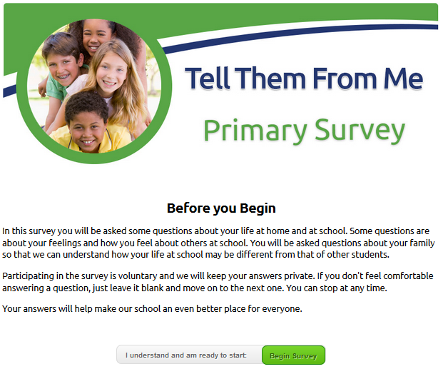
How is it done? (cont’d)
Please read the text on the screen.
Then click on ‘Begin Survey’ to start.
The survey will take around 25-30 minutes to complete.
0300AU0000

Slide 6
What kinds of questions will be asked?
All questions are multiple-choice.
You will be asked about a range of things, including some of the things you learn about and what you enjoy or find challenging.
The survey will also ask some more personal questions, such as what language you speak at home, whether you are Aboriginal or Torres Strait Islander and which parents or carers live at home with you.
0300AU0000

Slide 7
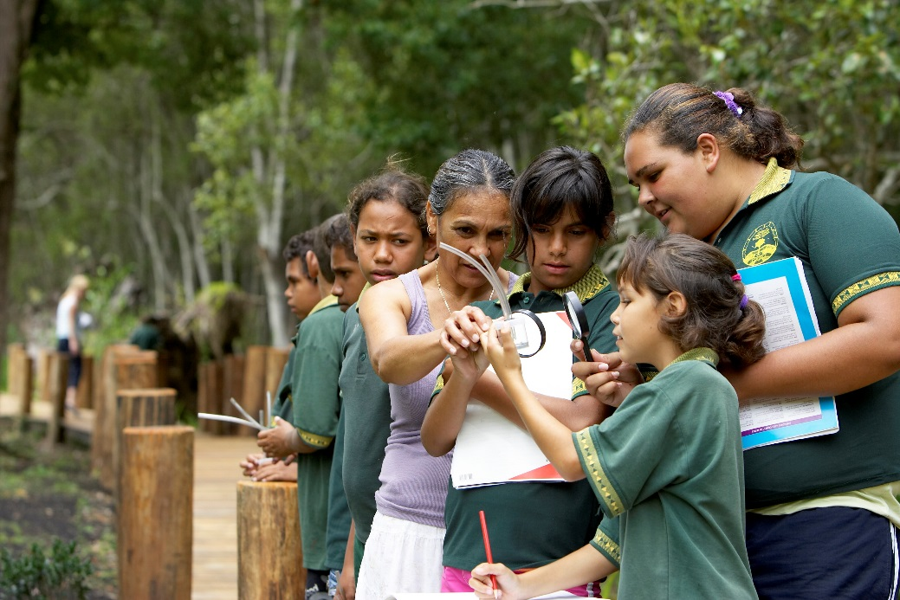
Why are we asked personal questions?
These questions will help your school make sure it is hearing from students from a range of backgrounds.
If you don’t feel comfortable answering a question, just leave it blank and move on to the next one.
If at any point you feel you don’t want to continue, just let your teacher know and you can stop.
0300AU0000

Slide 8
What do I need to remember when doing the survey?
Be open and honest when answering.
Make sure your answers reflect what you think – not what you think you are supposed to say.
There is no ‘back-button’. Once you complete and ‘submit’ a page, you cannot go back to it.
Take care when answering, but don’t worry if you mess up on a question or two.

Slide 9
Who sees this information?
Shortly after your school’s survey is closed, your teachers will receive survey reports.
The reports show the combined responses of all students. No-one at your school will know how you answered.
If fewer than 5 students respond to a question, the results will not be shown.
0300AU0000

Slide 10
How can I get more information about the survey?
If you have any questions about the survey, please see your teacher.
0300AU0000

Slide 11
Thank you! Your opinion matters.
0300AU0000

